Slide 1
Design and Implementation of a Small Scale Stand Alone Hybrid Solar PV and Wind Energy Generation
Team: Hussein Ghitan, Blaise Ronspies, Adam Schroeder, and Anna Schulte
Advisor/Client: Venkataramana Ajjarapu - Professor of Electrical Engineering
Team Website: https://sddec19-06.sd.ece.iastate.edu/ , Team Number: sddec19-06
Notes:
Explain why Ajjarapu is both our Advisor and Client

Slide 2
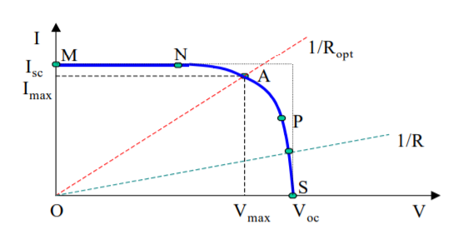
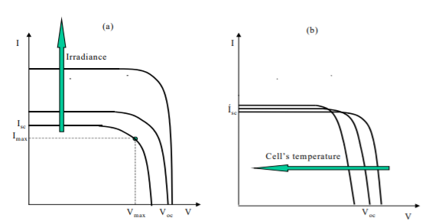
Introduction: Physics of PV System

Slide 3
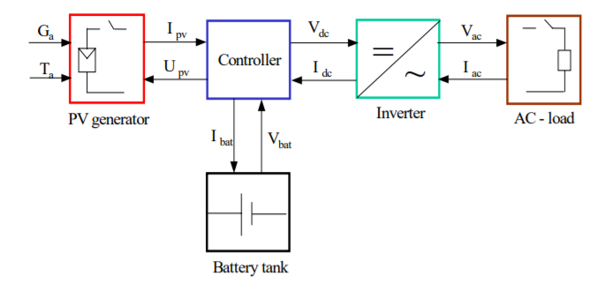
Project Plan: Problem Statement
Developing a PV stand-alone system for Electrical Engineering students, Power Electronics Class EE452
Solar Energy is the main source for photovoltaic systems
Generating direct and alternating current
Continuous work of 2017/2018 senior design teams
Notes:
First two bullet points explain the image
Explain what 2017 team did (Designed/Created the system) and what 2018 team did (Attempted to make it safer, in turn broke it)

Slide 4
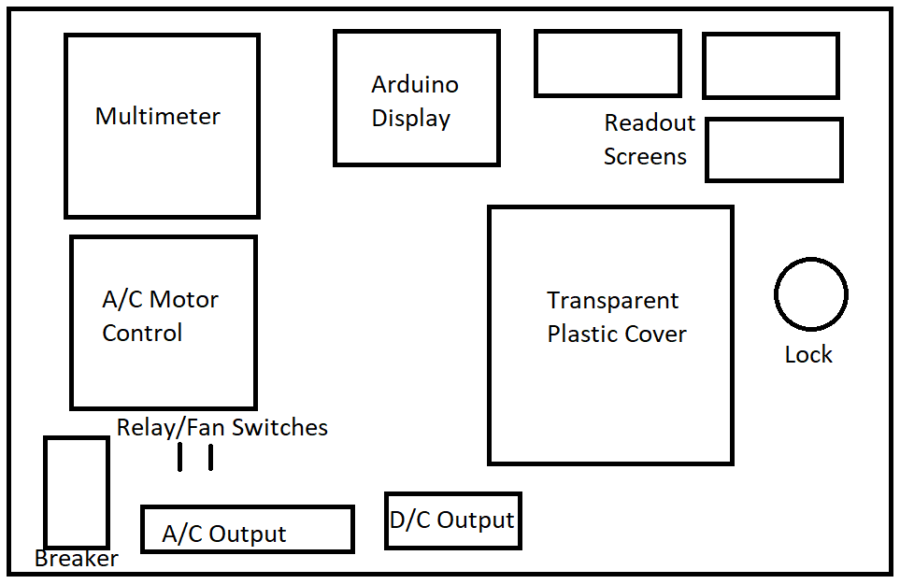
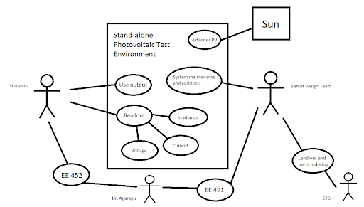
Project Plan: Conceptual Sketch

Slide 5
Project Plan: Functional Requirements
Irradiance is at its highest
Sizing the photovoltaic system
PV arrays
Battery
Maximum power point tracking (MPPT)
Wires
Load
Hardware and software designs must be comparable
Obtain the MPP for applying various loads
Notes:
Hussein
Sizing is the basis for PV system electrical design, and establishes the size and ratings for major components needed to meet a certain performance objective.

Slide 6
Project Plan: Non-functional Requirements
Safe to use
Reflect knowledge of EE452 students
Fit electrical engineering standards
Easily expand in the future
System should be visually pleasing and organized
Notes:
Hussein

Slide 7
Project Plan: Constraints and Considerations
Solar irradiance
Solar angle
Cloud coverage
Array position
Initial usability
Untrained use
Safety factors
High wattage
Short circuits
Notes:
Anna
Solar Irradiance - location, solar angle, cloud coverage, array position doesn’t allow for adjustments … lab times didn’t work with this
Initial usability - The system was not functioning when we started, which meant we had to spend time figuring out what each switch did and what each screen displayed (didn’t work)
Safety factors - solar going directly into breaker which we found was installed backwards and was causing a high open voltage across the breaker, there were also several short circuits in the system

Slide 8
Project Plan: Market Survey
Solar panels are becoming more popular in the power market today
Significance of our project and PV system
Education
Maximum Power Point (MPP)
Notes:
Anna
Solar panels are quickly becoming cheaper and more efficient
Significance: Instead of being designed for everyday use, our project is designed to allow students to understand how a PV system works:
significance of the MPP

Slide 9
Project Plan: Potential risks and Mitigation
Current and potential risks
High voltage and current
Some insulation needed
No labeling
Some wires are at risk of being cut
Battery location
Mitigation during this semester
Replaced breaker and battery
Short circuits
Notes:
Anna
Like we said previously, the solar was coming directly into the breaker
The system is not clearly labeled or explained so without the help of our senior design team or a TA the students could potentially be in danger
The way the batteries are currently it can be dangerous to disconnect/reconnect them … batteries need a breaker!!
High current for 1,2 5,16 ohms
Too much current through the MPPT requires a system reset which is currently requires the batteries to be completely disconnected

Slide 10
Project Plan: Resource and Cost Estimate
All resources applied by ECpE, Iowa State University
Three teams project costs include:
Resistors Box: $248.65 Resistor Clips: $31.4
Solar Panels: $350.00 x 2 Resistor Enclosure: $38.96
Batteries: $45.98 x 3 Circuitry Enclosure: $53.70
Circuit Breaker: $19.19 x 3 Buck Boost: $44.99
Arduino Uno Rev3: $22.00 x 2
Banana Pins: $.65 x 24
Fan: $5.87 x 3
Digital Multimeter: $19.99
Terminal Blocks: $5.60 x 4
Total Cost ≅ $1386.83
Notes:
Hussein
We purchased a battery ($45.98), and a breaker ($20.19)
?? Future costs ??
Solar Panels: $350.00 x 2 (depending on brands and specifications)
Batteries $45.98 x 3 (One battery has been replaced)
Additional Load: TBD
Overall cost of additional parts: $837.94 + Additional Load

Slide 11
Project Plan: Project Milestones and Schedule
Semester Milestones
Fixing breaker
Debugging circuits for power circuit
Creating lab manual for simulation and hardware experiments
Running lab successfully
Future Schedule
Addressing safety concerns
Testing and resolving any issues that arise from AC circuitry
Adding additional load
Adding wind energy to system
Notes:
Debugging circuits (Shorted circuits)
Explain the purpose of the lab manuals (deliverables for students)
Explain how lab went
Safety concerns - labeling, breaker for battery, insulation
Explain what needs to be done for AC circuitry

Slide 12
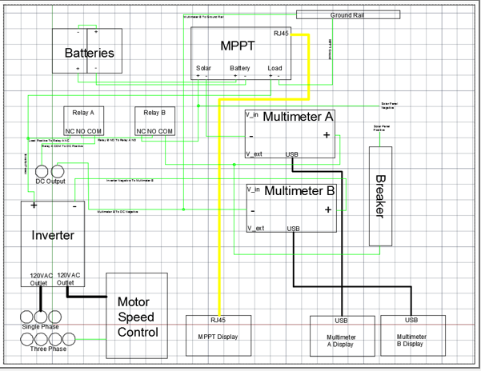
System Design: Detailed Design
Notes:
(From presentation template) Functional modules design, interface definition, user interfaces, etc

Slide 13
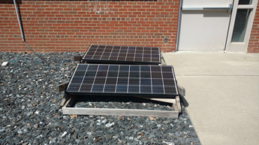
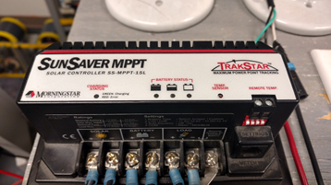
System Design: Functional Decomposition
DC Output Functional Decompositions:
Solar arrays generate electrical power
convert solar radiation into direct current electricity
Solar controller
MPPT tracks max power point and charges batteries
Batteries
Store energy supplied by a PV panels
Load
Resistors used to approximate MPP
Notes:
Hussein
-Talk about other components to generate the AC power like inverters

Slide 14
System Design: Hardware and Software Platforms
Hardware
Solar Array
Enclosure
Batteries
Loads
Software
Arduino
Meter wiring
PV model
All software related work used MATLAB/SIMULINK
Notes:
Hussein

Slide 15
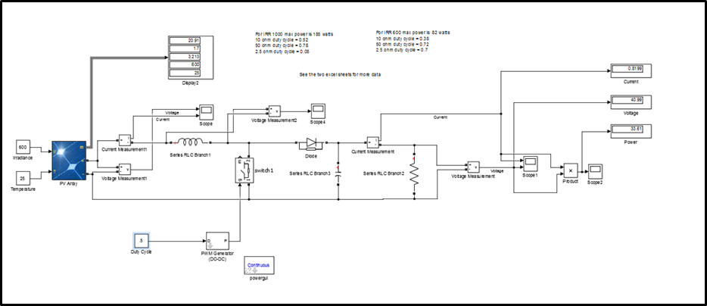
SOFTWARE: SIMULINK PV SYSTEM MODEL
Notes:
Hussein

Slide 16
System Design: Test Plan
Circuitry Debugging
Measure Voltage throughout circuit
Trigger switches and relays
Ensure proper safety measures
Lab Use
Team use and design testing
Students and peers
User with no prior knowledge
Notes:
As we have been working on it we have been careful to check voltages before working on anything, even if we are confident that it is disconnected.

Slide 17
System Design: Prototype Implementations
Previous semester projects
Proof of concept from first team
Most recent team created a product
Implementation timeline
Initially was not functional
Functional prototype by April
Final product by December
Prototype for next team

Slide 18
Conclusion: Current Project Status
Lab has been completed by the current EE 452 students
Power circuit to the DC output is functioning
Sensors and display circuits not functioning
AC power circuit has not been tested
Notes:
Anna
We have instructed/helped run lab using our system
The system is functioning but not safe
Sensors and display circuits not functioning
AC power circuit not tested

Slide 19
Conclusion: Next Semester
Definite Plans
Improve safety of system
Fix sensors and display circuit
Usability testing
Implement AC output
Possible Plans
Additional load
Wind energy system
Moveable solar
Notes:
Anna
Improve safety
Implement AC power circuit
Fix sensors and display circuit
Implement addition

Slide 20
Conclusion: Member Responsibility/Contributions
Hussein: Meeting Scribe, Webmaster
Blaise: Test Engineer
Adam: Lead Engineer
Anna: Meeting Coordinator
Notes:
Hussein -
Blaise -
Adam - Debugged short circuits, typed up experiments for lab, ran through all experiments to ensure they worked, ran/explained hardware portion of lab to students
Anna - Ran through lab experiments and adjusted lab manuals to ensure they made sense, managed team things such as ordering parts, setting up meetings (with previous member, several meetings with an ETG engineer), and setting up documents/reports.

Slide 21
Lab For EE 452 Students
EE452 experiments and answer key on,
Team Website: https://sddec19-06.sd.ece.iastate.edu/
Experiments done by current students of EE452
Solutions matched with provided answer key
Team members monitored experiments during lab
Future labs can be easily developed

Slide 22
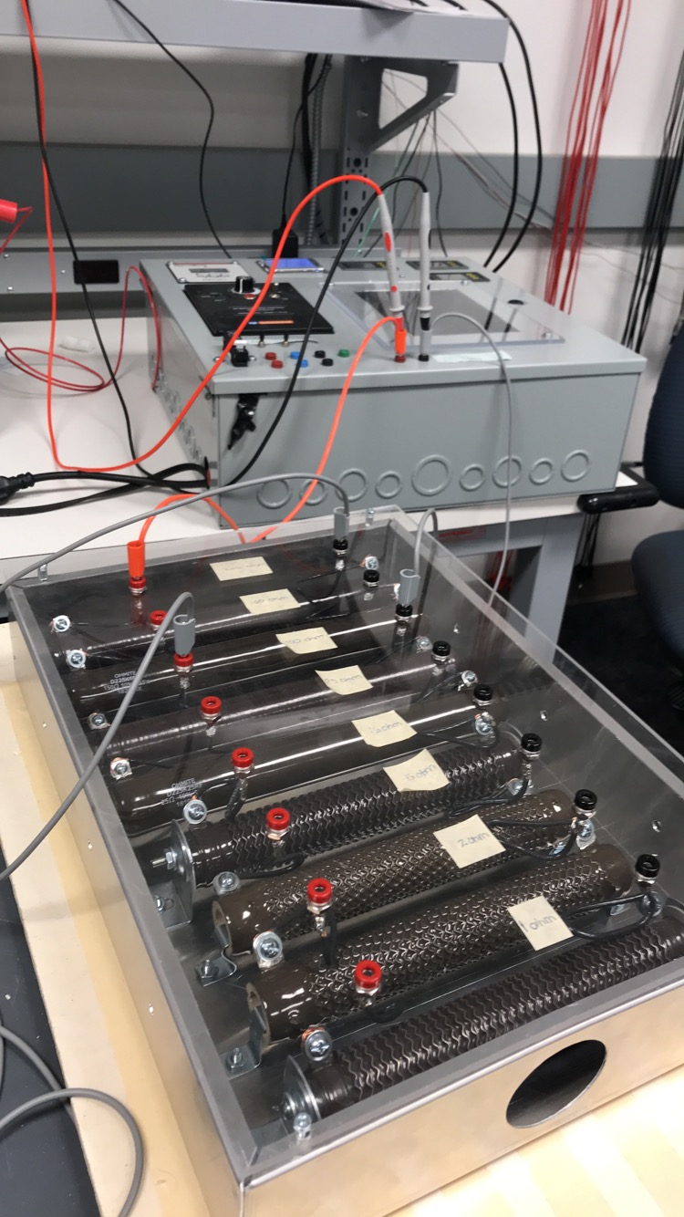
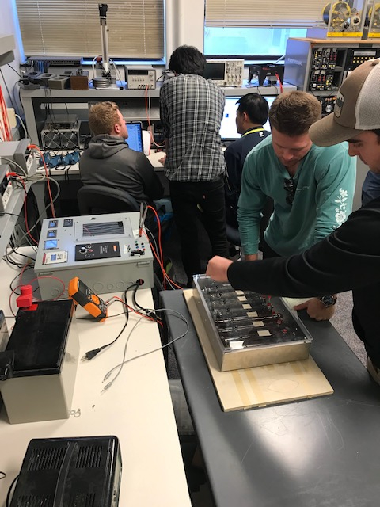
EE452 Lab Work

Slide 23
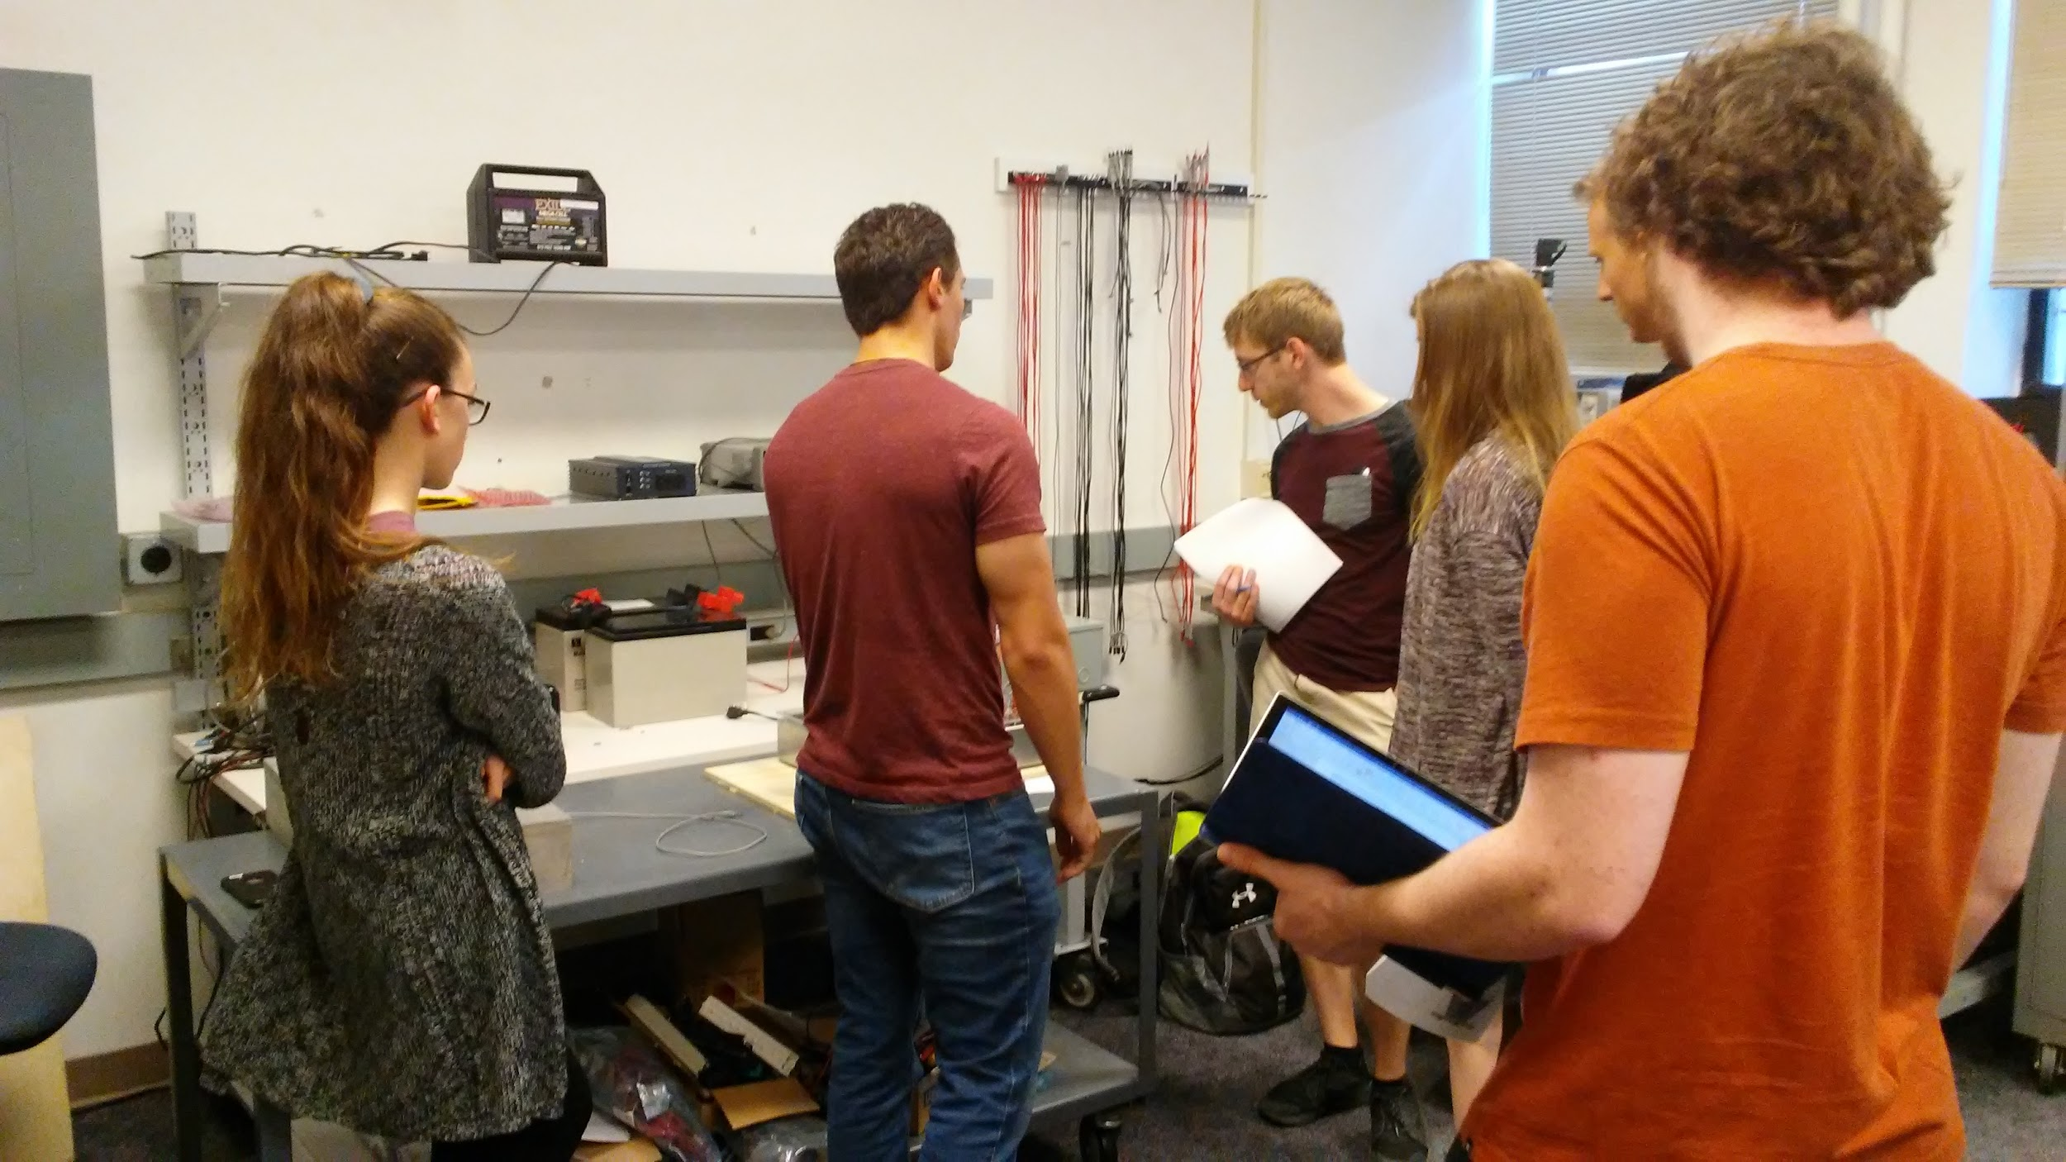
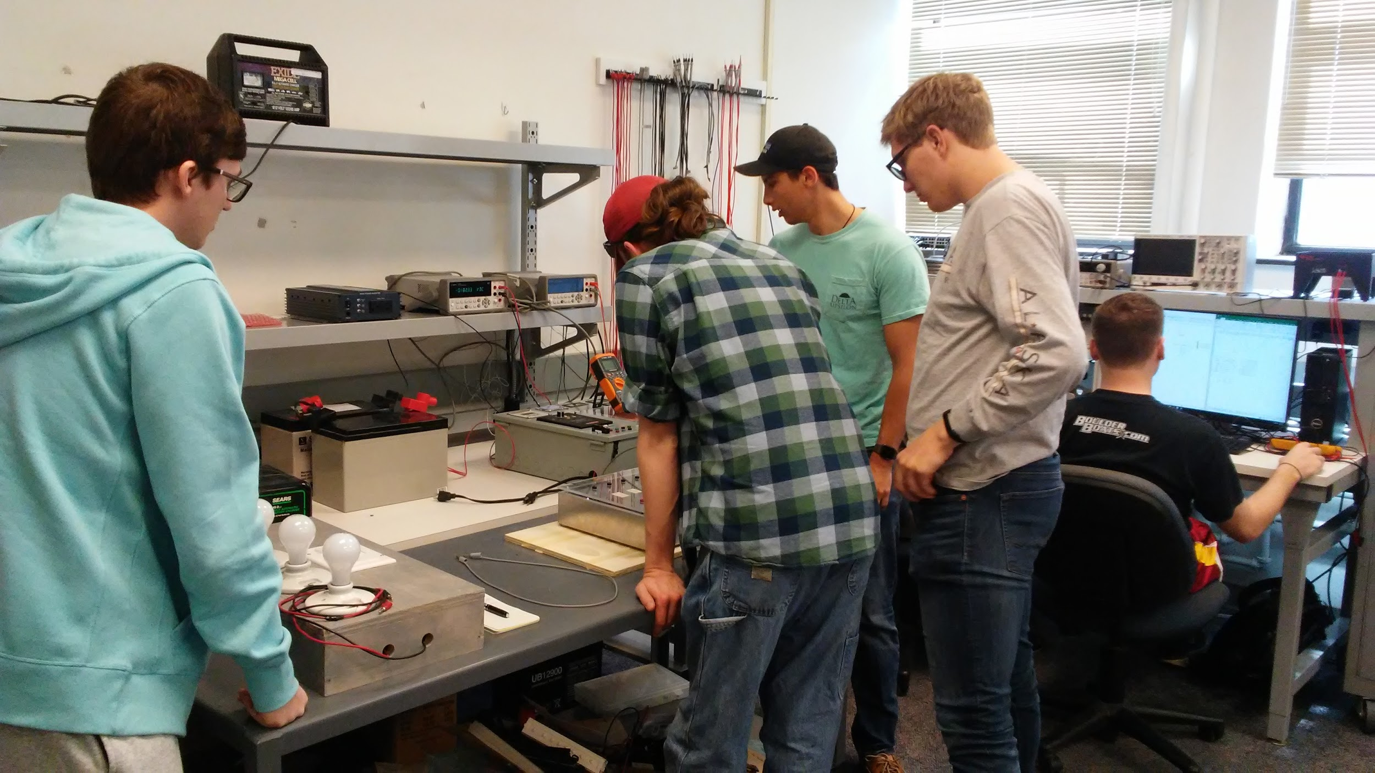
EE452 Lab Work

Slide 24
Questions?

